Slide 1
Apache Spark: An overview

Slide 2
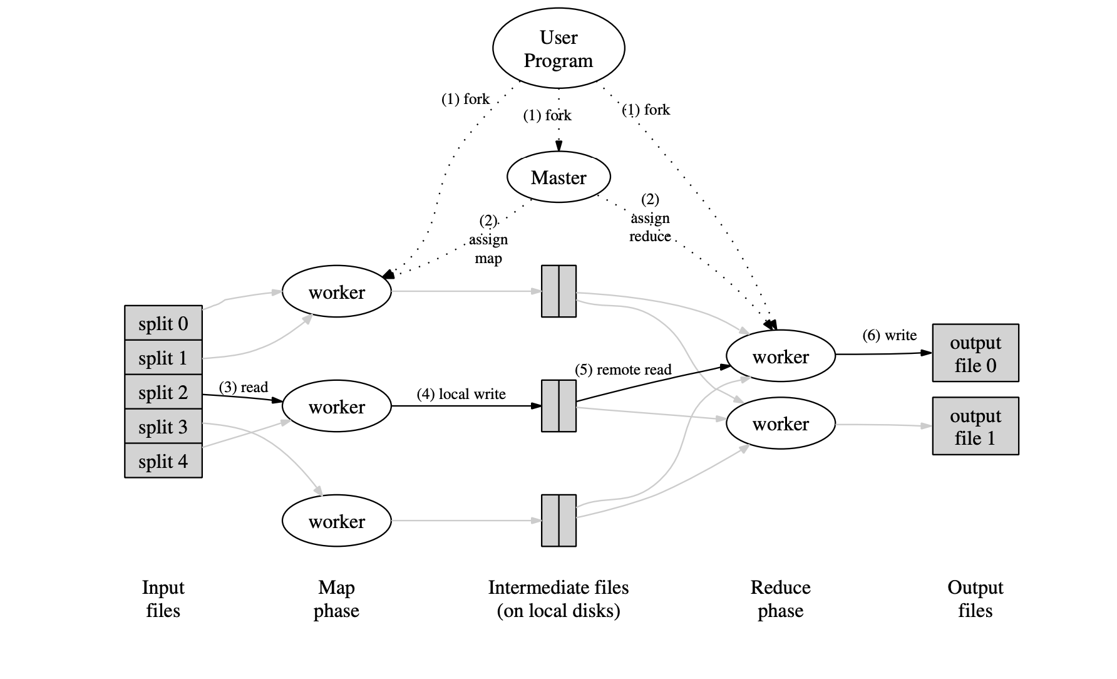
Map Reduce

Slide 3
ISSUES & limitations
Recall that the computation in MapReduce takes a set of input key/value pairs, and produces a set of output key/value pairs. The user writes Map(Reduce) which produces(consumes) intermediate key/value pairs. The master is the conduit through which the location of intermediate file regions is propagated from map tasks to reduce tasks.
However, this system, and others, are built around an acyclic data flow model that is not suitable for other popular applications.
Consider applications that reuse a working set of data across multiple parallel operations. This includes many iterative machine learning algorithms, as well as interactive data analysis tools.
Iterative jobs: Many common machine learning algorithms apply a function repeatedly to the same dataset to optimize a parameter (e.g., through gradient descent). While each iteration can be expressed as a MapReduce/Dryad job, each job must reload the data from disk, incurring a significant performance penalty
Interactive analysis: For performing ad hoc data analysis, querying a database is essential. Hadoop handles large volumes of data easily but querying multiple times is inefficient as Hadoop will run a MapReduce job for each such task and do repeated reads from disk.

Slide 4
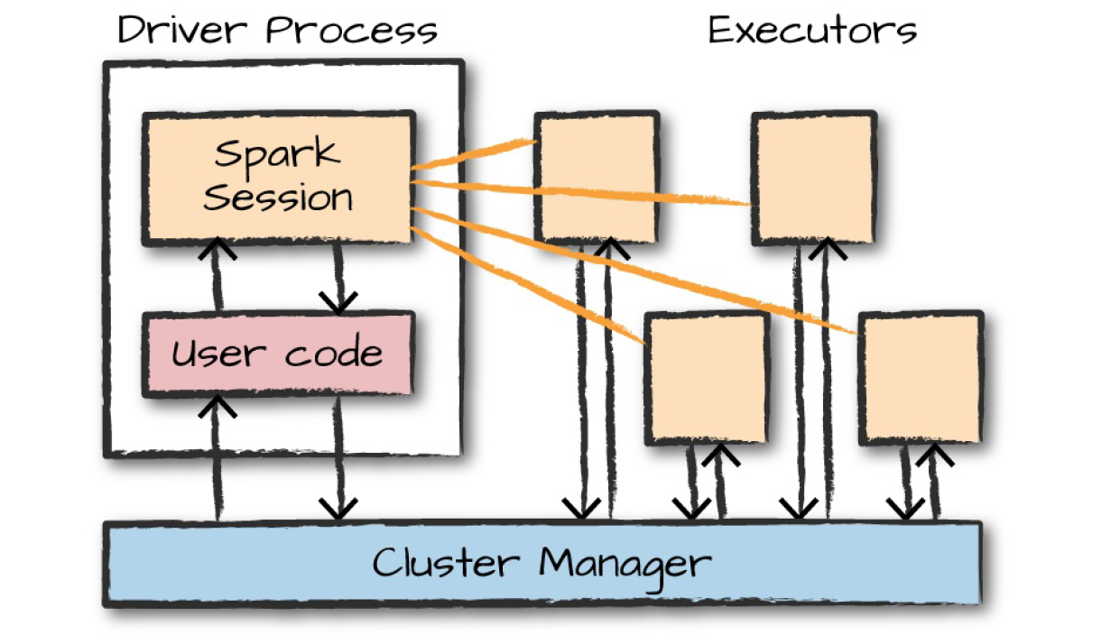
Spark is born!
The driver process runs the “main()” function, it sits on a node in the cluster, and is responsible for three things: maintaining information about the Spark Application, responding to a user’s program or input and analyzing, distributing, and scheduling work across the executors.
The most common mode of running Spark is Cluster mode where the driver process is running on a worker node and is managed by a cluster manager (e.g. Mesos or YARN). Another related mode is Client mode where the driver instead runs on the client side.

Slide 5
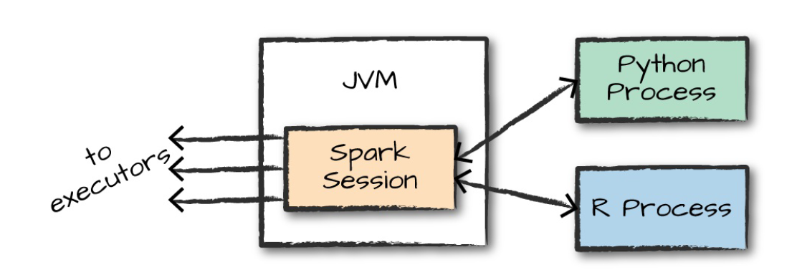
Spark is born!
The executors are responsible for actually carrying out the work that the driver assigns them and are responsible for only two things: executing code assigned to it by the driver, and reporting the state of the computation on that executor back to the driver node.
The cluster manager could be Spark’s standalone manager or YARN, Mesos etc.

Slide 6
Points on inner workings
The main abstraction in Spark is that of a resilient distributed dataset (RDD). It is a read-only collection of objects partitioned across a set of machines.
RDDs can be cached in memory and reused if a partition is lost. The latter is possible because the partitions carry enough information about how it was derived.
RDDs are represented as Scala object and can be created by users from either a file in a shared distributed file systems like HDFS or by parallelizing an array, for instance. (this will distribute it in various nodes). An e.g. in Python is
spark.range(10).toDF("id").rdd.map.(lambda row: row[0]).collect()
This prints: [0, 1, 2, 3, 4, 5, 6, 7, 8, 9]
Note: The RDDs are not same as Distributed shared memory(DSM). The main difference between RDDs and DSM is that RDDs can only be created (“written”) through bulk transformations, while DSM allows reads and writes to each memory location. This restricts RDDs to applications that perform bulk writes but allows for more efficient fault tolerance.

Slide 7
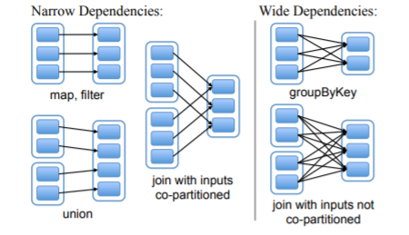
Points on inner workings
Spark follows “lazy evaluation”. In that, it will wait until the very last moment to execute the graph of computation instructions. Instead of modifying the data immediately when we express some operation, you build up a plan of transformations that you would like to apply to our source data.
By waiting until the last minute to execute the code, Spark compiles this plan from your raw DataFrame transformations to a streamlined physical plan that will run as efficiently as possible across the cluster.
Example of how “join” is done in Spark. Unlike operations like map or filter, join requires a “shuffle” operation.

Slide 8
Tuning spark
Tuning Spark can be tricky depending on the situation. Below methods are methods for some common scenarios.
Tuning Resource Allocation: Tune spark.executor.cores for setting the number of cores and spark.executor.memory for setting the heap memory.
In cluster mode --driver-memory can be tuned especially when applications require bringing large data back to driver, e.g. via collect()
Shuffle being an expensive operation where the data is written to the disk and so should be minimized when possible. So patterns like, groupByKey, join, repartition or reduceByKey can be avoided.

